Slide 1
Informed Search
Chapter 4

Slide 2
Search and Control Strategies
Word "Search" refers to the search for a solution in a problem space.
Search proceeds with different types of "Search Control strategies".
A strategy is defined by selection of the order in which the nodes expand.
The Search strategies are evaluated in the following dimensions:
Completeness,
Time complexity,
Space complexity,
Optimality.

Slide 3
Search related terms
Algorithm’s Performance and Complexity:
A common measure to compare approaches in order to select the most appropriate algorithm for a given situation.
◊ Performance of an algorithm depends on internal and external factors.
Internal factors
‡ Time required, to run
‡ Space (memory) required to run
External factors
‡ Size of input to the algorithm
‡ Speed of the computer
‡ Quality of the compiler
◊ Complexity is a measure of the performance of an algorithm.
It measures the internal factors, usually in time than space.

Slide 4
Computational Complexity:
A measure of resources in terms of Time and Space.
◊ If A is an algorithm that solves a decision problem f
then run time T of A is the number of steps taken on the input of length n.
◊ Time Complexity T(n) of a decision problem f is the run time of the 'best' algorithm A for f .
◊ Space Complexity S(n) of a decision problem f is the amount of memory used by the `best' algorithm A for f .

Slide 5
“Big - O” notation
The "Big-O“ is theoretical measure of the execution of an algorithm to give an approximation to the run-time-efficiency of an algorithm .
the letter “O” is for order of magnitude of operations or space at run-time.
◊ The Big-O of an Algorithm A
If algorithm A requires time proportional to n, then order of the algorithm is said to be O(n).
If algorithm A requires time proportional to n², then order of the algorithm is said to be O(n²).
If an algorithm A requires time proportional to f(n), then the algorithm A is said to be of order f(n), and it is denoted as O(f(n)).
The function f(n) is called the algorithm’s growth-rate function.
Similarly, for algorithms having performance complexity : O(log N), O(N log N) , O(2N) and so on.
Note: O(logn) < O(n ) < O(nlogn) < O(n² ) < O(n³ )

Slide 6
◊ Example 1 : 1-D array
determine the Big-O of an algorithm ;
Calculate the sum of the n elements in an integer array : a[0 . . . . n-1].
Line no Instructions No of execution steps
line 1 sum = 0 1
line 2 for (i = 0; i < n; i++) n+1
line 3 sum += a[i] n
line 4 print sum 1
Total = 2n+3
To determine the Big-O:
Ignoring constants such as 2 and 3, the algorithm is of the order n.
So the Big-O of the algorithm is O(n).
In other words the run-time of this algorithm increases roughly as the size of the input data n

Slide 7
◊ Example 2 : 2-D array
determine the Big-O of an algorithm ;
In a square 2-D array a[0 . . . . . n-1] [0 . . . . . n-1] , find the
largest element .
Line no Instructions No of execution steps
line 1 max = a[0][0] 1
line 2 for (row = 0; row < n; row++) n+1
line 3 for (col = 0; col < n; col++) (n+1)(n+1)
line 4 if (a[row][col] > max) max = a[row][col]. n*(n)
line 5 print max 1
Total = 2n² +3n+4
To determine the Big-O:
Ignoring the constants such as 2, 3 and 4, the algorithm is of
order n². So the Big-O of the algorithm is O(n²).
In other words, run-time of this algorithm increases roughly as the square of the size of the input data which is n²

Slide 8
Search
Search is the systematic examination of states to find path from the start/root state to the goal state.
− search explores knowledge alternatives to arrive at the best answer.
− search algorithm output is a solution (a path) from the initial state to a state that satisfies the goal test.
− search deals with finding nodes having certain properties in a graph that represents search space.
− search methods explore the search space "intelligently", evaluating possibilities.

Slide 9
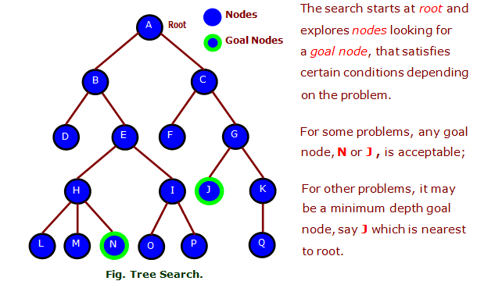
Example : Search tree
The search trees are multilevel indexes used to guide the search for data items, given some search criteria.

Slide 10
Search Algorithms :
There are two types of search:
Uninformed Search :
Also called blind, exhaustive or brute-force القوة الغاشمة search, uses no information about the problem to guide the search and therefore may not be very efficient.
Informed Search :
Also called heuristic or intelligent search, uses information about the problem to guide the search, usually guesses the distance to a goal state, and therefore efficient, but the search may not be always possible.

Slide 11
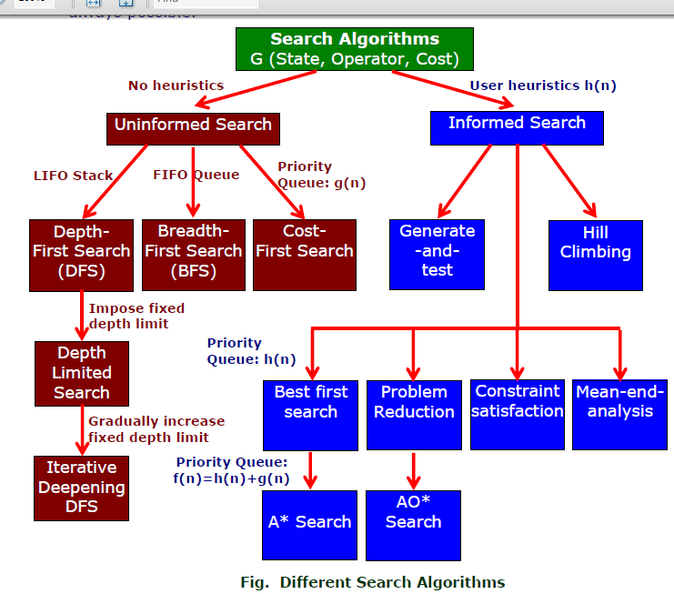

Slide 12
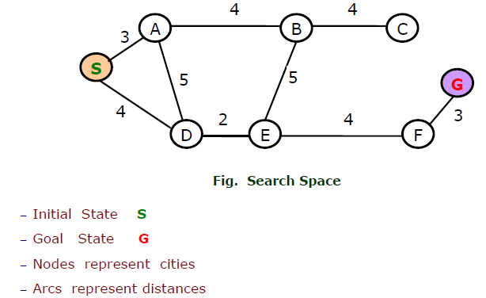
Search Space
A set of all states , which can be reached, constitute a search space.
Example :
Find route from Start to Goal state.
Consider the vertices as city and the edges as distances.

Slide 13
Search notations
Search is the systematic examination of states to find path from the start or root state to the goal state.
The notations used for defining search are:
− h(n) is heuristic function that estimates least cost path from node n to goal node.
− g(n) is cost function that estimates least cost path from start node to node n.
− f(n) is evaluation function that estimates least cost Path (solution) through node n.
Where, f(n) = g(n) + h(n)

Slide 15
Estimate Cost Function g*
◊ An estimated least cost path from start node to node n, is written as g*(n).
◊ g* is known by summing all path costs from start to current state.
◊ If search space is a tree, then g* = g, because there is only one path from start node to current node.
◊ If search space is a graph,
then g* ≥ g,

Slide 16
Estimate Heuristic Function h*
◊ An estimated least cost path from node n to goal node , is written as h*(n)
◊ h* is a heuristic information, it represents a guess;
◊ h* may be estimated using an evaluation function f(n) that measures "goodness" of a node.
◊ h* may have different values (based on experience)
the values lie between 0 ≤ h*(n) ≤ h(n);
they mean a different search algorithm.
◊ If h* = h , it is a "perfect heuristic";
it means no unnecessary nodes are ever expanded.

Slide 17
Control Strategies
Search for a solution in a problem space, requires "Control Strategies" to control the search processes.
Strategies for Search
Some widely used control strategies for search are:
1. Forward search :
Here, the control strategies for exploring search proceeds forward from initial state towards a solution;
This strategy is called data-directed.
2. Backward search :
Here, the control strategies for exploring search proceeds backward from a goal or final state towards either a solvable sub problem or the initial state;
This strategy is called goal-directed.

Slide 18
3. Both forward and backward search :
Here, the control strategies for exploring search is a mixture of both forward and backward strategies .
4. Systematic search :
Where search space is small, a systematic (but blind) method can be used to explore the whole search space.
One such search method is depth-first search
the other is breath-first search.
5. Heuristic search :
Many search depend on the knowledge of the problem domain. They have some measure of relative merits to guide the search. The search so guided are called heuristic search and the methods used are called heuristics .
Note : A heuristic search might not always find the best solution but it is guaranteed to find a good solution in reasonable time.

Slide 19
Condition-action rules
− one way of encoding Knowledge is condition-action rules
− the rules are written as:
if < condition> then < conclusion >
◊ Chaining
− Chaining refers to sharing conditions between rules, so that the same condition is evaluated once for all rules.
− When one or more conditions are shared between rules, they are considered "chained."
− Chaining are of two types :
− Forward chaining is called data-driven And
− Backward chaining is called query-driven

Slide 20
Forward Chaining Algorithm
Forward chaining is a technique for drawing inferences from Rule base.
Forward-chaining inference is often called data driven.
◊ The algorithm
Proceeds from a given situation to a desired goal, adding new assertions (facts) found.
◊ A forward-chaining, system compares data in the working memory against the conditions in the IF parts of the rules and determines which rule to fire.
◊ Data Driven

Slide 21
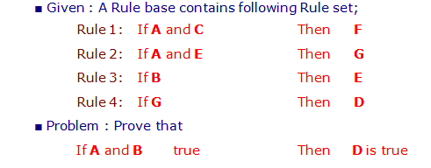
◊ Example : Forward Channing

Slide 22
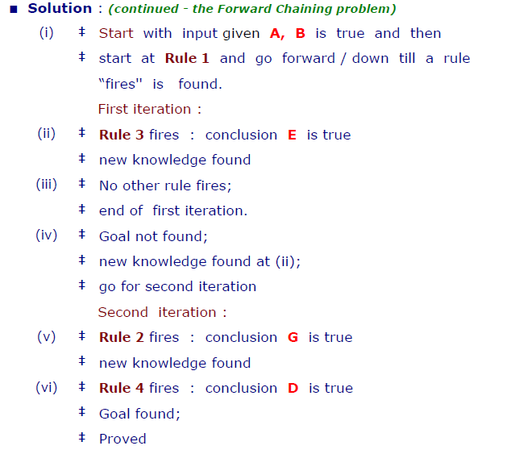

Slide 23
Backward Chaining Algorithm
Backward chaining is a techniques for drawing inferences from Rule base.
Backward-chaining inference is often called goal driven.
The algorithm proceeds from desired goal, adding new assertions found.
A backward-chaining, system looks for the action in the THEN clause of the rules that matches the specified goal.

Slide 24
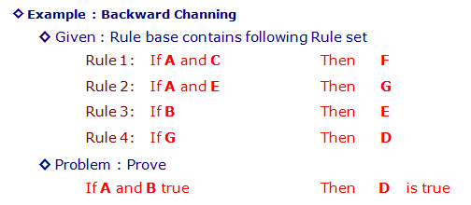

Slide 25
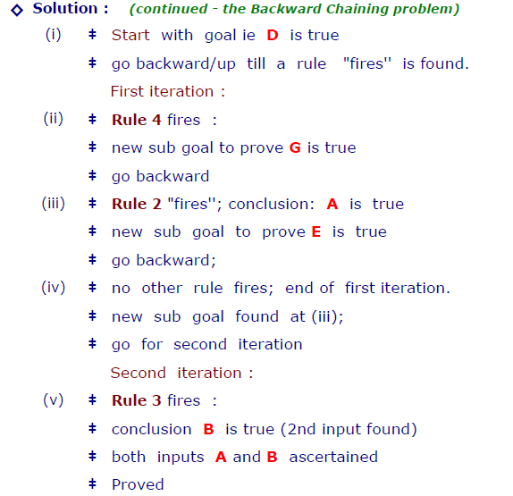

Slide 26
Heuristic Search Techniques
For complex problems, the traditional Blind Searching algorithms, are unable to find the solution within some practical time and space limits.
Consequently, many special techniques are developed, using heuristic functions. قواعد تعتمد على الخبرة
− Blind search is not always possible, because they require too much time or Space (memory).
− Heuristics are rules of thumb; they do not guarantee for a solution to a problem.
− Heuristic Search is a weak technique but can be effective if applied correctly; they require domain specific information

Slide 27
Characteristics of Heuristic Search
◊ Heuristics, are knowledge about domain, which help search and reasoning in its domain.
◊ Heuristic search incorporates domain knowledge to improve efficiency over blind search.
◊ Heuristic is a function that, when applied to a state, returns value as estimated merit of state, with respect to goal.
◊ Heuristic evaluation function estimates likelihood of given state leading to goal state.

Slide 28
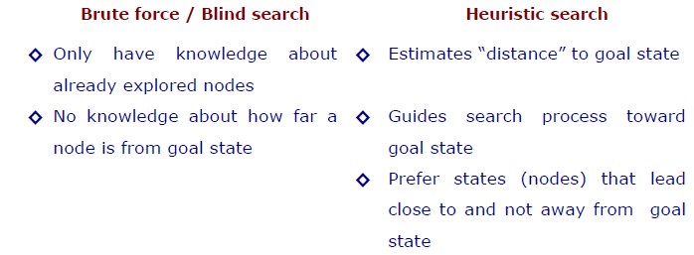
Heuristic Search compared with other search
The Heuristic search is compared with Brute force or Blind search techniques
Compare Algorithms

Slide 29
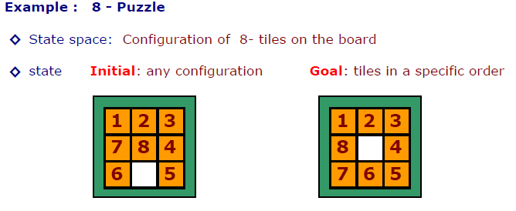
◊ Solution: optimal sequence of operators
◊ Action: “blank moves”
Condition: the move is within the board
Directions: Left, Right, Up, Dn
◊ Problem
- which 8-puzzle move is best?
- what heuristic(s) can decide?
- which move is “best” (worth considering first) ?

Slide 31
◊ Apply the Heuristic :
Three different approaches
- Count correct position of each tile, compare to goal state
- Count incorrect position of each tile, compare to goal state
- Count how far away each tile is from it is correct position.
Approaches Left Right Up
1. Count correct position 6 4 5
2. Count incorrect position 2 4 3
3. Count how far away 2 4 4

Slide 32
◊ Heuristic :
Three different approaches
■ 1st approach :
Count correct position of each tile, compare to goal state.
‡ Higher the number the better it is.
‡ Easy to compute (fast and takes little memory).
‡ Probably the simplest possible heuristic.
■ 2nd approach
Count incorrect position of each tile, compare to goal state
‡ Lower the number the better it is.
‡ The “best” move is where lowest number returned by heuristic.
■ 3rd approach
Count how far away each tile is from it’s correct position
‡ Count how far away (how many tile movements) each tile is from
it’s correct position.
‡ Sum up these count over all the tiles.
‡ The “best” move is where lowest number returned by heuristic.

Slide 33
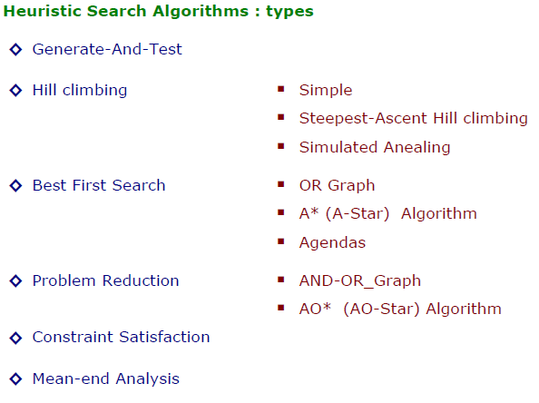

Slide 34
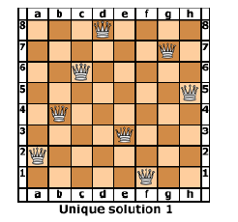
Eight Queens Puzzle Problem :
How can one put 8 queens on a (8 x 8) chess board such that no queen can attack any other queen ?
the puzzle has 92 distinct solutions.
Humans would find it hard to solve N-Queens puzzle while N becomes more.

Slide 35
The possible number of configurations are :
− For 4-Queens there are 256 different configurations.
− For 8-Queens there are 16,777,216 configurations.
− For 16-Queens there are 18,446,744,073,709,551,616 configurations.
- in general for N configurations, there N^{N} Configurations.
− For N = 16, this would take about 12,000 years on a fast machine.
How do we solve such problems ?
Three computer based approaches or models are stated below. They are
‡ Generate and Test (GT) ,
‡ Backtracking (BT) and
‡ Constrain Satisfaction Problems (CSPs)

Slide 36
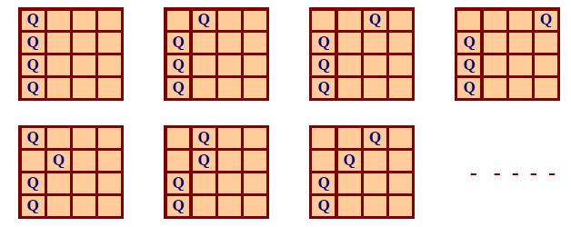
◊ Generate and Test (GT) : n = 4 Queens puzzle
One possible solution is to systematically try every placement of queens
until we find a solution.
The process is known as "Generate and Test".
Examples of Generate and Test conditions for solutions :

Slide 37
◊ Backtracking (BT) : n = 4 Queens puzzle
The Backtracking method is based on systematic examination of the possible solutions.
− The algorithms try each possibility until they find the right one.
− It differs from simple brute force, which generates all solutions, even those arising from infeasible partial solutions.
Backtracking is similar to a depth-first search but uses less space,
keeping just one current solution state and updating it.
‡ during search, if an alternative does not work, the search backtracks to the choice point, the place which presented different alternatives, and tries the next alternative.
‡ when the alternatives are exhausted, the search returns to the previous choice point and tries the next alternative there.
‡ if there are no more choice points, the search fails.

Slide 38
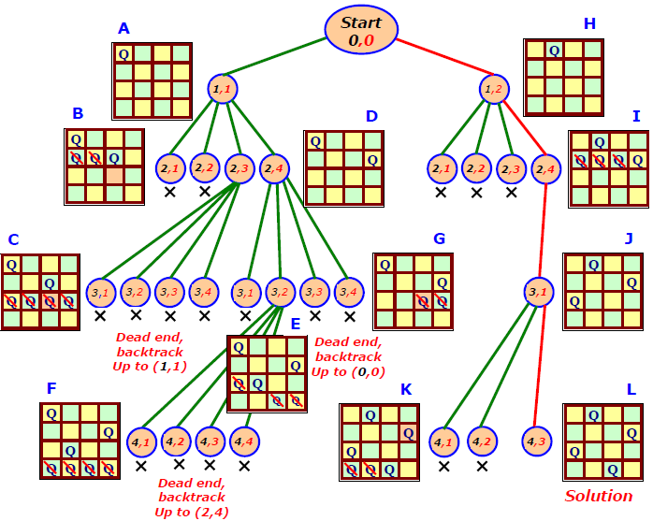
Example : Backtracking to solve N = 4 Queens problem.

Slide 39
Backtracking to solve N Queens problem.
The problem proceeds either by rows or by columns.
for no particularly good reason, select columns to proceed.
for each column, select a row to place the queen.
Algorithm
1. Move “left to right” processing one column at a time.
2. For column J, select a row position for the queen. Check for feasibility.
a. If there are one or more attacks possible from queens in columns 1 through (J – 1), discard the solution.
b. For each feasible placement in column J, make the placement and try placement in column (J + 1).
c. If there are no more feasible placements in column J, return to column (J – 1) and try another placement.
3. Continue until all N columns are assigned or until no feasible solution is found.

Slide 40
Best-first search
Idea: use an evaluation function f(n) for each node
The evaluation measures distance to Goal. Expand lowest evaluation unexpanded node
Implementation:
use priority Queue that maintain the nodes in fringe in ascending order of f-values.
Special cases:
Greedy best-first search
A* search

Slide 41
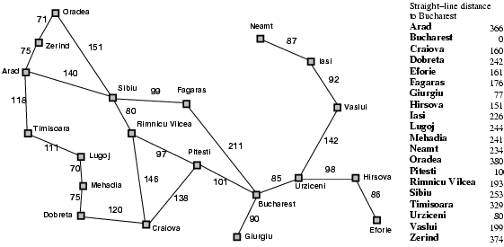
Romania with step costs in km

Slide 42
Greedy best-first search
Greedy best-first search expands the node that appears to be closest to the goal
It evaluates nodes by using just the heuristic function h
Evaluation function f(n) = h(n) (heuristic)
= estimate of cost from n to goal
Ex:
h_{SLD}(n) = straight-line distance from n to Bucharest
Note: h_{SLD} cannot be computed from the problem description. (it is Heuristic data gain from experience)

Slide 43
Greedy best-first search example

Slide 44
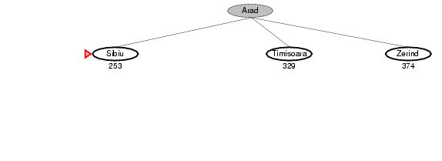
Greedy best-first search example

Slide 45
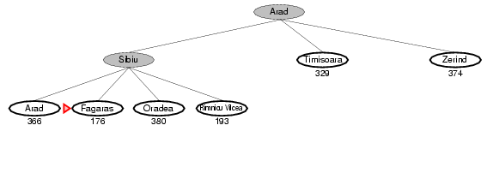
Greedy best-first search example

Slide 46
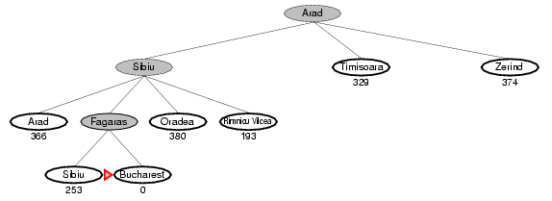
Greedy best-first search example

Slide 47
Properties of greedy best-first search
Complete? No – can get stuck in loops, (Iasi → Neamt → Iasi → Neamt ) , or dead end (start node = lasi, goal node = faragas, heuristic suggests that be expanded first) Neamt
Time? O(b^{m}), but a good heuristic can give dramatic improvement ( m = maximum depth of search) Space? O(b^{m}) -- keeps all nodes in memory Optimal? No
the path (Arad, Rimnicu Vilcea, Pitesti, Bucharest) is Shorter than that selected by Greedy (Arad, Sibiu, Faragas, Bucharest).
This shows why the algorithm is called “Greedy” طماع

Slide 48
A* search
Idea:
evaluates nodes by combining the cost to reach the node g(n) and the cost to get from node to goal h(n)
Evaluation function f(n) = g(n) + h(n)
g(n) = cost so far to reach n
h(n) = estimated cost from n to goal
f(n) = estimated total cost of path through n to goal

Slide 49
A* search example

Slide 50
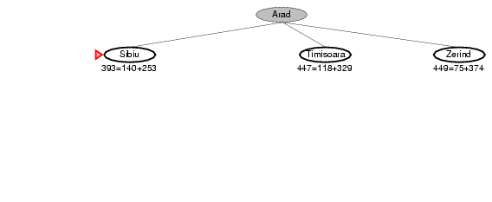
A* search example

Slide 51
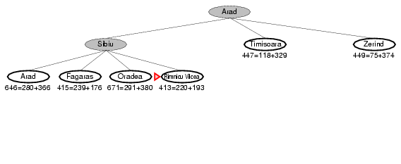
A* search example

Slide 52
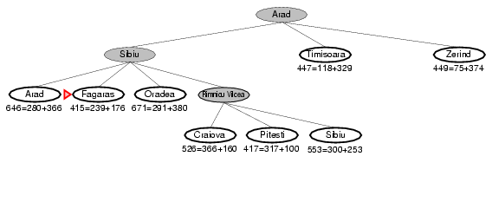
A* search example

Slide 53
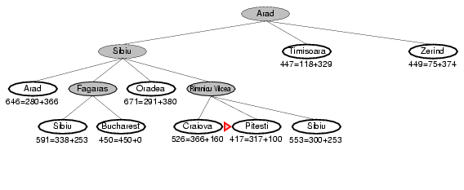
A* search example

Slide 54
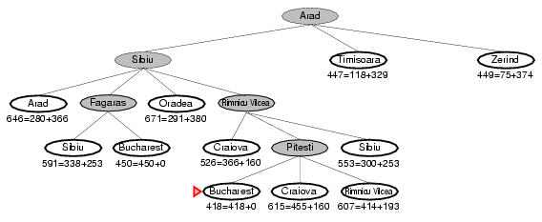
A* search example

Slide 55
Assignment
Hill-climbing search
Case study :
Eight Queens Puzzle Problem

